Slide 1

463.12
Web Privacy
Honey, why are you getting ads for sexy lingerie?
Computer Security II
CS463/ECE424
University of Illinois

Slide 2

What is “Privacy”?
Difficult-to-define concept.
Commonly refers to the desires and expectations of individuals about how, when, what, and to whom information about themselves is revealed to others.
Contrasts with security, which concerns protection against malicious attackers seeking to steal data or disrupt operations.

Slide 3
Privacy Norms are Universal but Variable
Scholars have uncovered evidence of privacy-seeking behaviors across peoples and cultures separated by time and space: from ancient Rome and Greece to preindustrialized Javanese, Balinese, and Tuareg societies.
The Quran instructs against spying on one another;
The Talmud advises home-builders to position windows so that they do not directly face those of one’s neighbors;
The Bible relates how Adam and Eve discovered their nakedness after eating the fruit of knowledge and covered themselves in shame from the prying eyes of God.

Slide 4
Example
Privacy
Security
If Alice tells her friend Bob a personal fact about herself in confidence, like, say, that she has been diagnosed with cancer, and then Bob mentions this in a Facebook comment, Alice may well consider this a violation of her privacy.
If Alice responds to a phishing email and reveals her personal banking password to a hacker who accesses her bank account, then Alice is a victim of a security breach.
This is probably also a privacy breach since Alice probably would not reveal her bank balance to a stranger.

Slide 5
Alan Westin Surveys
Influential classification and surveys from early 1990s contrast three types of attitudes towards privacy
Privacy Fundamentalists
Privacy Unconcerned
Privacy Pragmatists
[Kumaraguru05]
Notes:
WESTIN, A., AND HARRIS LOUIS & ASSOCIATES. Harris-Equifax Consumer
Privacy Survey. Tech. rep., 1991. Conducted for Equifax Inc. 1,255 adults of the
U.S. public.
http://reports-archive.adm.cs.cmu.edu/anon/isri2005/CMU-ISRI-05-138.pdf

Slide 6
Questionaire
Respondents were asked
  Whether they are very concerned about threats to their personal privacy today,
  Whether they agree strongly that business organizations seek excessively personal information from consumers,
  Whether they agree strongly that the Federal government since Watergate is still invading the citizen’s privacy, and
  Whether they agree that consumers have lost all control over circulation of their information.

Slide 7
Questionaire
Respondents were asked
  Whether they are very concerned about threats to their personal privacy today,
  Whether they agree strongly that business organizations seek excessively personal information from consumers,
  Whether they agree strongly that the Federal government since Watergate is still invading the citizen’s privacy, and
  Whether they agree that consumers have lost all control over circulation of their information.

Slide 8
Privacy Fundamentalists
Fundamentalists are
  Generally distrustful of organizations that ask for their personal information,
  Worried about the accuracy of computerized information and additional uses made of it, and
  In favor of new laws and regulatory actions to spell out privacy rights and provide enforceable remedies.
They generally choose privacy controls over consumer-service benefits when these compete with each other.
Notes:
WESTIN, A., AND HARRIS LOUIS & ASSOCIATES. Harris-Equifax Consumer
Privacy Survey. Tech. rep., 1991. Conducted for Equifax Inc. 1,255 adults of the
U.S. public.
http://reports-archive.adm.cs.cmu.edu/anon/isri2005/CMU-ISRI-05-138.pdf

Slide 9
Privacy Unconcerned
Privacy unconcerned assert that they do not see what the “privacy fuss” is all about. They
Support the benefits of most organizational programs over warnings about privacy abuse,
Have little problem with supplying their personal information to government authorities or businesses, and
See no need for creating another government bureaucracy (a “Federal Big Brother) to protect someone’s privacy.

Slide 10
Privacy Pragmatists
Privacy pragmatists
  Weigh the value to them and society of various business or government programs calling for personal information,
  Examine the relevance and social propriety of the information sought,
  Want to know the potential risks to privacy or security of their information,
  Look to see whether fair information practices are being widely enough observed,
They use these and similar factors to decide whether they will agree or disagree with specific information activities.
  Their trust in the particular industry or company involved is a critical decisional factor.
Privacy pragmatists favor voluntary standards and consumer choice over legislation and government enforcement.
  But they will back legislation when they think not enough is being done (or meaningfully done) by voluntary means.

Slide 11
Survey Results
 | 1990 | 1991
Fundamentalists | 46% | 41%
Unconcerned | 17% | 20%
Pragmatists | 36% | 39%

Slide 12
Privacy Paradox
There arose doubts about the power of attitudinal scales to predict actual privacy behavior.
This discrepancy between attitudes and behaviors has become known as the “privacy paradox.”
At least three factors seem relevant
  Uncertainty
  Context Dependence
  Malleability and Influence
[Acquisti15]

Slide 13
Uncertainty
People are often uncertain about which privacy choices to make
Exacerbating factors of technology include incomplete and asymmetric information
Experiments often show disregard for privacy versus other factors
Not always, however: consider this endowment effect field experiment.
Anonymous gift cards worth $10 versus identified cards worth $12.
Do you want to trade?
Of the subjects who originally held the less valuable but anonymous card, five times as many (52.1%) chose it and kept it over the other card than did those who originally held the more valuable card (9.7%).
This suggests that people value privacy more when they have it than when they do not.
Notes:
In fact, attempts to pinpoint exact valuations
that people assign to privacy may be misguided,
as suggested by research calling into question the
stability, and hence validity, of privacy estimates.
In one field experiment inspired by the literature
on endowment effects (32), shoppers at a mall
were offered gift cards for participating in a nonsensitive
survey. The cards could be used online or
in stores, just like debit cards. Participants were
given either a $10 “anonymous” gift card (transactions
done with that card would not be traceable
to the subject) or a $12 trackable card (transactions
done with that card would be linked to
the name of the subject). Initially, half of the
Participants were given one type of card, and half
the other.
Then, they were all offered the opportunity
to switch. Some shoppers, for example,
were given the anonymous $10 card and were
asked whether they would accept $2 to “allowmy
name to be linked to transactions done with the
card”; other subjects were asked whether they
would accept a card with $2 less value to “prevent
my name from being linked to transactions done
with the card.”
Of the subjects who originally held
the less valuable but anonymous card, five times
as many (52.1%) chose it and kept it over the
other card than did those who originally held the
more valuable card (9.7%). This suggests that
people value privacy more when they have it
than when they do not.
--------------------------
If you were given the $12 card and asked, “hey would you like to reduce its value by $2 in order to assure your name is not used?” then had only 9.7% of liking that deal.
Logically you might think this means that when you are given the $10 card and asked, “hey would you like to get $2 more if we can share your name” then you’d have something like a 90% chance of liking that deal.
But no, the endowment effect kicks in and and most people prefer to stay with the privacy card (52.1%) if they already have it.

Slide 14
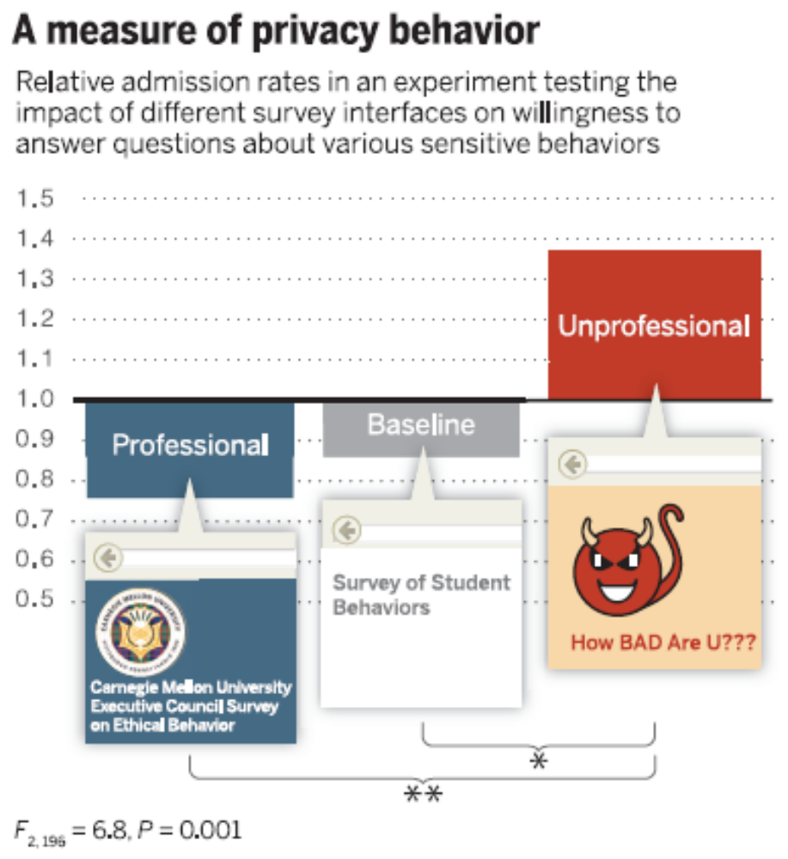
Context Dependence
Although desire for privacy is widespread, individual seek clues in their environment about rules. Examples
  Take comfort in government regulation
  Do what others do
However, clues can lead to worrisome places. Example:
  Revealing private information to a computer agent
Notes:
The impact of cues on
disclosure behavior.A measure
of privacy behavior often used in
empirical studies is a subject’s
willigness to answer personal,
sometimes sensitive questions—
for instance, by admitting or
denying having engaged in
questionable behaviors. In an
online experiment (47), individuals
were asked a series of
intrusive questions about their
behaviors, such as “Have you
ever tried to peek at someone
else’s e-mail without them
knowing?” Across conditions,
the interface of the questionnaire
was manipulated to look
more or less professional. The
y axis captures the mean affirmative
admission rates (AARs)
to questions that were rated as
intrusive (the proportion of
questions answered affirmatively)
normed, question by question,
on the overall average AAR for the question. Subjects revealed more personal and even incriminating
information on the website with a more casual design, even though the site with the formal interface was
judged by other respondents to be much safer.The study illustrates how cues can influence privacy behavior
in a fashion that is unrelated, or even negatively related, to normative bases of decision-making.

Slide 15
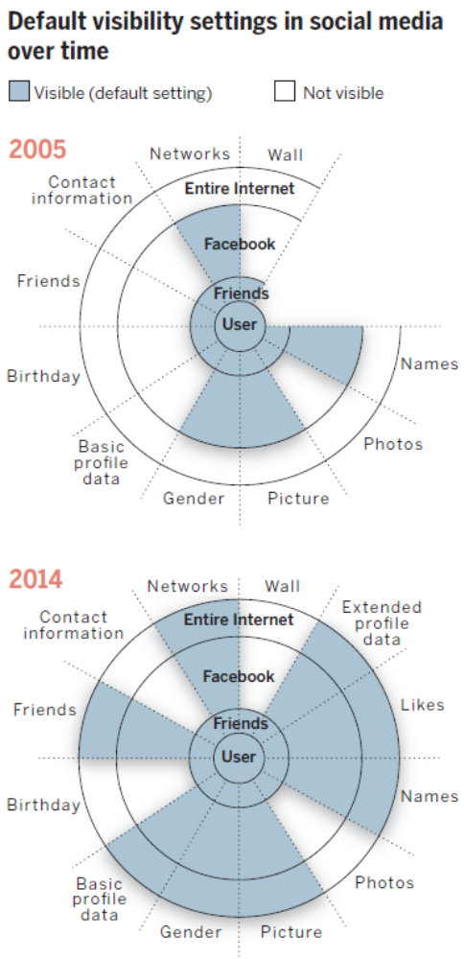
Malleability and Influence
Because they are not sure what they want and are often led by subtle clues in their privacy decisions, individuals are subject to manipulation. Examples:
  Posting a privacy policy that users do not read may lead to comfort
  Offering many privacy choices can lead to less privacy
  Default configuration
Notes:
Changes in Facebook
default profile visibility settings
over time (2005–2014).
Over time, Facebook profiles
included an increasing amount of
fields and, therefore, types of
data. In addition, default visibility
settings became more revelatory
between 2005 (top) and 2014
(bottom), disclosing more personal
information to larger audiences,
unless the user manually
overrode the defaults (fields such
as “Likes” and “Extended Profile
Data” did not exist in 2005).
“Basic profile data” includes
hometown, current city, high
school, school (status, concentration,
secondary concentration),
interested in, relationship,
workplace, about you, and quotes.
Examples of “Extended profile
data” include life events such as
new job, new school, engagement,
expecting a baby, moved, bought
a home, and so forth. “Picture”
refers to the main profile image.
“Photos” refers to the additional
images that users might have
shared in their account. “Names”
refers to the real name, the username,
and the user ID. This figure
is based on the authors’ data and
the original visualization created
by M. McKeon, available at
http://mattmckeon.com/
facebook-privacy.

Slide 16


Slide 17
Display Advertising
Advertisers want the ads for their products to reach plausible clients.
  Ford wants to inform those people interested in buying a car about a new model and they are willing to pay for this service.
Publishers are willing to place ads on their webpages, but they expect to be paid in return.
  Eg. New York Times newspaper
Brokers mediate between advertisers, publishers, and clients: the advertisers send their ads and bids to the broker, who then distributes them to the publishers’ webpages, which are in turn viewed by users.
  Eg. Google and Yahoo
The client may click on an ad if she finds it to be relevant to her needs or interests.
For every ad viewed in the pay-per-view (PPV) advertising model or clicked in the pay-per-click (PPC) advertising model, the advertiser pays the broker who in turn pays the publisher.

Slide 18
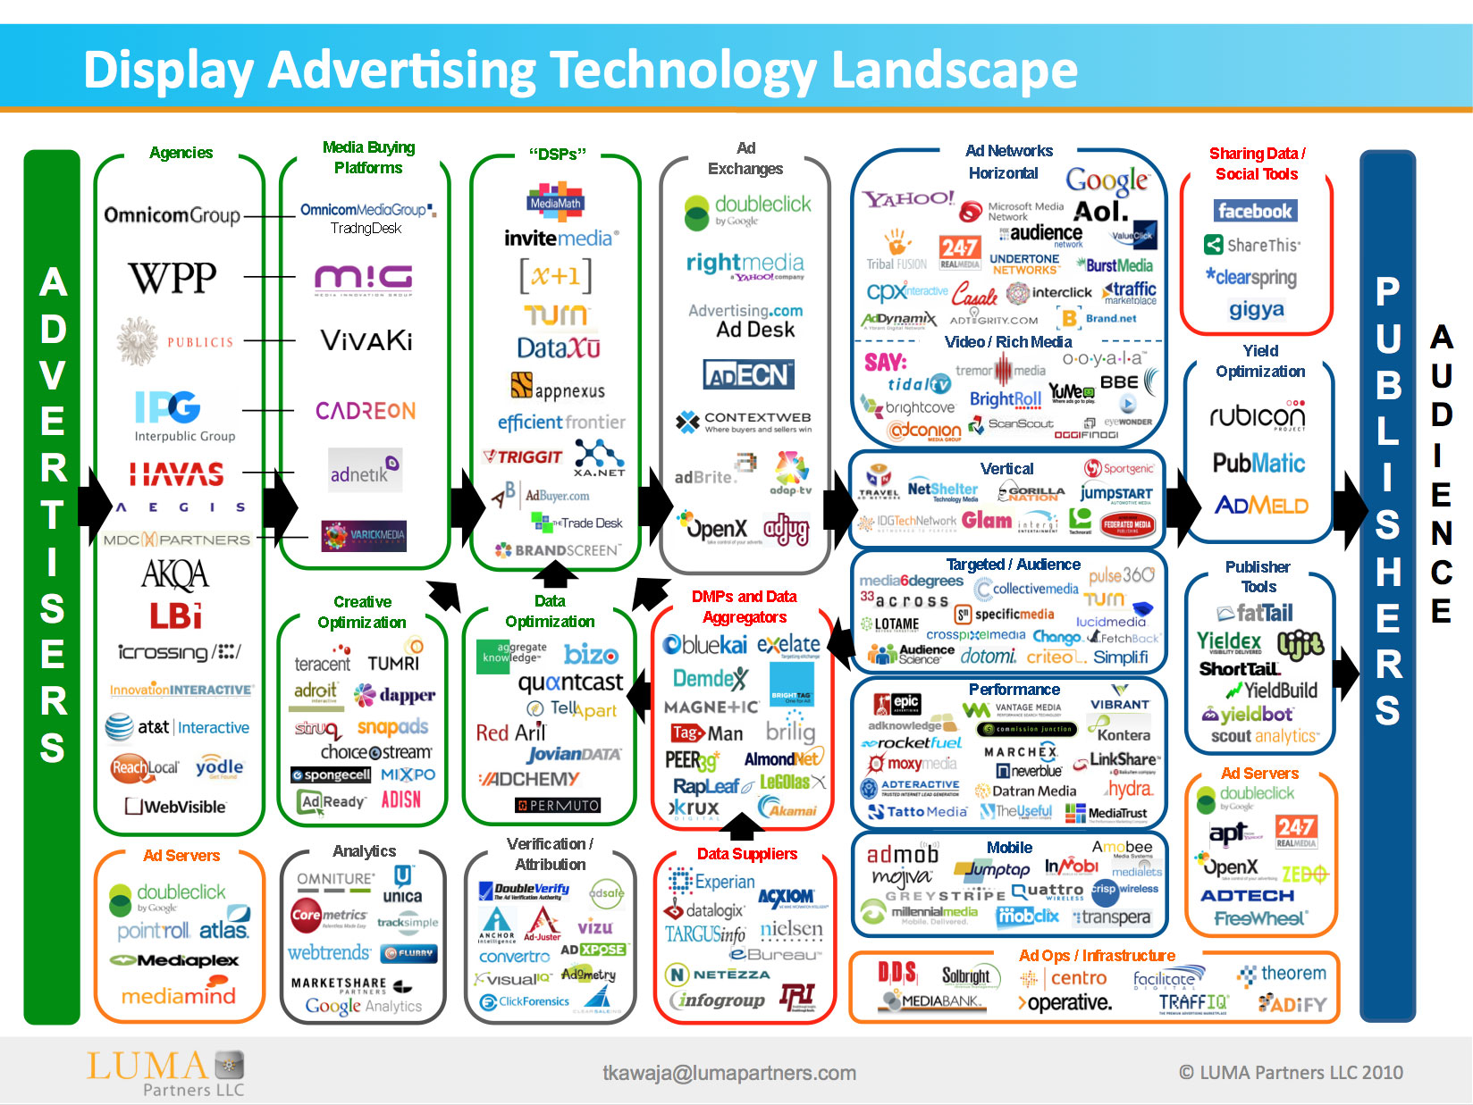

Slide 19
Online Behavioral Advertising (OBA)
Publishers embed a link for the broker on their webpages.
  The sole purpose of these broker links is user tracking.
When a user views the webpage, the user’s browser contacts the broker’s servers.
This enables the broker to track the user across all partnering publishers.
The broker then runs its own algorithm over the tracked data to decide which ad to present on the publisher’s page.
This tracking practice poses a threat to the privacy of users:
  Research has shown that it is often possible to link tracked information to personally identifying information of the user.
Notes:
B. Krishnamurthy and C. E. Wills, “Cat and mouse:
content delivery tradeoffs in web access,” in Proc.
International World WideWeb Conference (WWW’06),
2006, pp. 337–346.
B. Krishnamurthy and C. E. Wills, “Privacy diffusion on the web: a longitudinal
perspective,” in Proc. International World WideWeb
Conference (WWW’09), 2009, pp. 541–550.

Slide 20
OBA Auction Scenario
Trackers
Publishers
Advertisers
Broker (Ad exchange)
Client

Slide 21
Trackers
U
U
Publishers
U
Advertisers
Broker (Ad exchange)
Trackers track users
Compile user profile
Client

Slide 22
Trackers
U
U
Publishers
U
Advertisers
U
U
U
Broker (Ad exchange)
Trackers (may) share profiles with advertisers
Client

Slide 23
Trackers
U
U
Publishers
U
Advertisers
U
U
U
Broker (Ad exchange)
Client gets webpage with
adbox
Client

Slide 24
Trackers
U
U
Publishers
U
Advertisers
U
U
U
Client tells broker of page
Broker (Ad exchange)
Client

Slide 25
Trackers
U
U
Publishers
U
Advertisers
U
U
U
Broker (Ad exchange)
Broker launches auction (for given user visiting given webpage ….)
Also does clickfraud etc.
Client

Slide 26
Trackers
U
U
Publishers
U
Advertisers
U
U
U
Broker (Ad exchange)
Or publisher launches auction
Client

Slide 27
Trackers
U
U
Publishers
U
Advertisers
U
U
U
Broker (Ad exchange)
Advertisers present bids and ads
Client

Slide 28
Trackers
U
U
Publishers
U
Advertisers
U
U
U
Broker (Ad exchange)
Broker picks winners,
delivers ads
Client

Slide 29
Trackers
U
U
Publishers
U
Advertisers
U
U
U
Broker (Ad exchange)
Broker waits for results
Client

Slide 30
Trackers
U
U
Publishers
U
Advertisers
U
U
U
Broker (Ad exchange)
Reports them to interested parties
Client

Slide 31
Current Second Price Auctions for Advertising
How do we select which ads to show to which users and how do advertisers pay Cost Per Click (CPC) on the ads they provide?
  Bid B
  Global quality score (at broker) G
  User quality score (at user) U
  Rank = B × G × U
  CPC = B_{n} ( G_{n} × U_{n} / G_{c} × U_{c})
    Where B_{n} , G_{n} , U_{n} are for the next lowest bid and B_{c}, G_{c}, U_{c} are for the current (winning) bid
[Resnichenko11]
Notes:
A second bid auction is sometimes known as a Vickrey auction. In this case the auction is determined by rank rather than bid alone, and the payment of the bid winner is scaled according to the quality scores of the current and next bidder.
Note that since Bn x Gn x Un <= Bc x Gc x Uc we must have CPC <= Bc

Slide 32
Quality Scores
Historical click performance of the ad
Landing page quality
…….
Relevance to the user
User click through rates
…….
Known at broker
(call it G)
Known at user
(call it U)

Slide 33
Is OBA a Violation of Privacy?
Linking behavioral data with unique identifiers
Detail and scope of data collection
OBA based on “negative” assumptions
Sensitivity of data
Impact on operability
Ease of opting out
Lack of notice
Notes:
The 7 ‘creep factors’ of online behavioral advertising
Shade Cutter
VentureBeat.com
February 22, 2012
http://venturebeat.com/2012/02/22/the-7-creep-factors-of-online-behavioral-advertising/
Creep Factor No. 1: Linking behavioral data with unique identifiers
One of the most powerful ways to deliver targeted ads to consumers is to assign a unique identifier to individuals and track their online behavior across multiple sites, platforms, and apps. However, as Apple found when its use of UDIDs (Unique Device Identifiers) resulted in a public outcry, this is also one of the practices consumers find most disturbing. Although Apple is eliminating the use of UDIDs from its development platform, app developers (and their marketing executives) are pushing hard to find alternatives. Some mobile marketing companies advocate the use of MAC addresses in lieu of UDIDs. Others have proposed an open source UDID alternative. Setting aside security concerns associated with some of the UDID alternatives (MAC addresses? Really?), the problem with these alternatives is they aren’t really any less unnerving than the technology they seek to replace.
Creep Factor No. 2: Detail and scope of data collection
Most people have some tolerance for “being watched.” After all, we’re social creatures, and we understand that, at some level, others will observe what we do and try to gain advantages from what they learn. But there’s a point at which data collection can make consumers feel like they’re trapped in a kind of Orwellian Panopticon. For example, if a data collection practice is both broad (i.e., relating to behavior in multiple contexts, like emailing, texting, web browsing, and voice calling) and granular (i.e., capturing details of the behavior, as in keystroke-logging), expect a sharp rise in the sale of tin-foil hats, because consumers will do anything to avoid this kind of practice. Just ask companies like Phorm and NebuAd, who partnered with Internet Service Providers a couple of years ago to use deep-packet inspection technology to deliver targeted ads to users. If you want to know how that story ends, you can read all about it in the transcripts of the congressional hearing.
Creep Factor No. 3: OBA based on “negative” assumptions
It’s hard to envision how regulators would address this issue, since it’s inherently subjective, but it’s still relevant. OBA is all about making assumptions based on known features of the consumer. However, these assumptions can have negative, positive, or neutral connotations. If the underlying assumptions are negative, consumers will likely find this intrusive. For example, if I’m a marathon runner, I’m perfectly fine getting targeted ads promoting the latest workout app. If I’m a pudgy couch potato…not so much. (I’m a 42-year old attorney who spends most of his day sitting in front of a computer monitor, so you can guess which scenario I identify with.) Consumers are much more likely to find OBA based on negative assumptions (e.g., you’re fat and need to work out) intrusive, not to mention tacky.
Creep Factor No. 4: Sensitivity of data
There’s a reason the ancient penalty for peeping Toms was gouging out their eyes. Some data is so sensitive that, even if it’s anonymized, consumers will not tolerate its collection and use. For a notably disconcerting example, read the Wall Street Journal’s reporting on Neilson Co.’s practice of scraping a privateonline forum for discussion threads from people suffering from emotional disorders. Neilson was monitoring what consumers were saying about various pharmaceutical products on the forum. The information Neilson collected wasn’t tied to individuals and wasn’t used for direct marketing purposes. But when the story broke, you could almost hear consumers sharpening their stakes.
Creep Factor No. 5: Impact on operability
This is one issue that courts view as a legally cognizable harm. If data collection and tracking technology significantly impacts the operability of users’ computers or mobile devices, as in the case of spyware, adware, and malware, the sense of intrusion can be overwhelming. Consumers will run, not walk, away from these kinds of practices.
Creep Factor No. 6: Ease of opting out
Zombie cookies are one example of this issue. They’re HTTP cookies that are automatically recreated (I prefer the word “respawned”—much creepier) after users attempt to delete them. This technology can make it virtually impossible for users to opt out of being tracked. Any company using zombie cookies to collect or monetize sensitive information is about as wholesome as John Hinckley, Jr.
Creep Factor No. 7: Lack of notice
Online apps and services may provide various types of notice to users about what’s being done with their data, but it’s safe to say that any OBA data-collection practice conducted with absolutely no consumer notice is seriously disturbing. A good example of this is a practice called “device fingerprinting.” Device fingerprinting creates a unique identifier for computers, cell phones, and other devices based on a combination of externally observable characteristics like installed font styles, clock settings, and TCP/IP configuration. In addition to being problematic because it creates a persistent, unique identifier (see “Creep Factor No. 1”), this information is collected “passively,” and in most instances users can’t even detect that it’s happening.

Slide 35
Do-Not-Track Requirements
Anonymity
Unlinkability
The broker cannot associate any unit of learned information with Personally Identifiable Information (PII) of any user (including network address).
Requires an anonymizing proxy.
The broker cannot associate separate units of learned information with a single (anonymous) client. This prevents a broker from building up a user profile, and then associating it with a known user using externally gathered knowledge.

Slide 36
Market Concerns
Advertisers, publishers, and brokers have their own concerns.
  Targeting ads makes ad dollars more effective. Avoid rules that constrain it excessively.
  Privacy rules must not significantly impact performance. Customers are sensitive to delays.
  Privacy rules must respect the competitive concerns of participants. E.g. advertisers compete and do not want their bids disclosed.
  Do not interfere with preventing fraud (such as click fraud).

Slide 37
Strategies for Privacy Protection
Encourage trust in the data server (“don’t be evil”)
  Current state of affairs, but there is concern…
Make decisions on the client device so private information is never shared with the data server
  Don’t send U to the server
Transform data from the client so that privacy risks of the transformed data on the server are limited
  Send something derived from U but not U itself
Use a trusted third party

Slide 38
Three flavors of Non-Tracking auctions
Client
(U)
Broker
(Bid, G)
Rank@Client
Bid, G
Rank@Broker
U
3
Bid, G
Rank@3rdParty
U
party
[Reznichenko11]

Slide 39
Three flavors of Non-Tracking auctions
Client
(U)
Broker
(Bid, G)
Rank@Client
Bid, G
Rank@Broker
U
3
Bid, G
Rank@3rdParty
U
party
[Kumaraguru05]

Slide 40
Client
(U)
Broker
(Bid, G)
A - the ad ID,
Value of (B × G),
E[B,G],
(+ targeting etc.)
Computes ranking:
(B × G) × U

Slide 41
Client
(U)
Broker
(Bid, G)
A - the ad ID,
Value of (B × G),
E[B,G],
(+ targeting etc.)
Computes ranking:
(B × G) × U
Time
A_{c} - clicked ad ID
((B_{n} × G_{n}) × U_{n} / U_{c})
E[B_{c}, G_{c}]
Decrypts E[B_{c}, G_{c}]
Computes CPC:
((B_{n} × G_{n}) × U_{n} / U_{c}) / G_{c}
Checks that CPC ≤ B_{c}

Slide 42
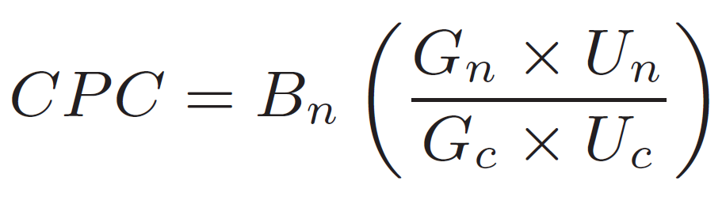
Client
(U)
Broker
(Bid, G)
Decrypts E[B_{c}, G_{c}]
Computes CPC:
((B_{n} × G_{n}) × U_{n} / U_{c}) / G_{c}
Checks that CPC ≤ B_{c}

Slide 43
Client
(U)
Broker
(Bid, G)
User information obscured by hiding within this composite value
A - the ad ID,
Value of (B × G),
E[B,G],
(+ targeting etc.)
Computes ranking:
(B × G) × U
A_{c} - clicked ad ID
((B_{n} × G_{n}) × U_{n} / U_{c})
E[B_{c}, G_{c}]
Decrypts E[B_{c}, G_{c}]
Computes CPC:
((B_{n} × G_{n}) × U_{n} / U_{c}) / G_{c}
Checks that CPC ≤ B_{c}

Slide 44
Client
(U)
Broker
(Bid, G)
A - the ad ID,
Value of (B × G),
E[B,G],
(+ targeting etc.)
Computes ranking:
(B × G) × U
A_{c} - clicked ad ID
((B_{n} × G_{n}) × U_{n} / U_{c})
E[B_{c}, G_{c}]
Decrypts E[B_{c}, G_{c}]
Computes CPC:
((B_{n} × G_{n}) × U_{n} / U_{c}) / G_{c}
Checks that CPC ≤ B_{c}

Slide 45
Client
(U)
Broker
(Bid, G)
Nuance: B_{c} and G_{c} may have changed between ranking and CPC calculation
A - the ad ID,
Value of (B × G),
E[B,G],
(+ targeting etc.)
Computes ranking:
(B × G) × U
A_{c} - clicked ad ID
((B_{n} × G_{n}) × U_{n} / U_{c})
E[B_{c}, G_{c}]
Decrypts E[B_{c}, G_{c}]
Computes CPC:
((B_{n} × G_{n}) × U_{n} / U_{c}) / G_{c}
Checks that CPC ≤ B_{c}

Slide 46
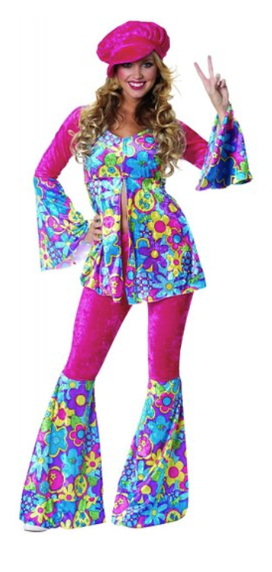
Privad: a privacy preserving ad system
13K opted-in users in Sep. and Oct. 2013
~4800 active users per day
Only in October
  ad requests ______
  ads ______
  ad views ____
  ad clicks _____
  product purchases ___
1.1M
9.5M
790K
417
4
Notes:
Private-by-Design Advertising Meets the Real World
Alexey Reznichenko, Paul Francis
CCS, 2014
http://dl.acm.org/citation.cfm?id=2660305

Slide 47
Privad: a privacy preserving ad system
CTR comparable to Google “display text ads”
In general “search ads” achieve better CTR than “display ads”
Majority of users who opted-in are tech-savvy with many of them having ad blocking software, browse in private mode and rarely click on ads
Notes:
CTR Click-through-rate
Search ads: ads displayed on top of the search engine when you search for a product
Display ads: ads shown in ad boxes when you visit a publisher’s website
Display text ads: Display ads with only text
Private-by-Design Advertising Meets the Real World
Alexey Reznichenko, Paul Francis
CCS, 2014
http://dl.acm.org/citation.cfm?id=2660305

Slide 49
Reading
[Kumaraguru05] Privacy Indexes: A Survey of Westin’s Studies, Ponnurangam Kumaraguru and Lorrie Faith Cranor. Technical Report CMU-ISRI-5-138, 2005.
[Acquisti15] Privacy and human behavior in the age of information. Acquisti, Alessandro, Laura Brandimarte, and George Loewenstein. Science 347.6221 (2015): 509-514.
[Reznichenko11] Auctions in Do-Not-Track Compliant Internet Advertising, Alexey Reznichenko, Saikat Guha, and Paul Francis. CCS 2011.

Slide 50
Discussion Questions
What kind of privacy person are you? Why? Can you think of a case were you (or others) were influenced by factors like context?
Analyze the likely views of users from various privacy profiles and factors with respect to OBA.
  Example: what might be the role of manipulation and influence?
Notes:
Obama Weighing Security and Privacy in Deciding on Spy Program Limits
By DAVID E. SANGER
Published: December 19, 2013
http://www.nytimes.com/2013/12/20/us/politics/obama-weighing-security-and-privacy-in-deciding-on-spy-program-limits.html?_r=0

